Slide 1
Computer Architecture: Memory Caches and Performance
Dr. Colin O’Flynn

Slide 2
Lectures
How does a program run on a machine?
How do you compile from high-level code to machine code?
How does the machine run? (Control Flow)
How does the machine store data?
How does the machine interface using buses?
What does it mean to have “allowed” memory?
Why is some memory faster & slower?
How does the machine speed up data access?

Slide 3
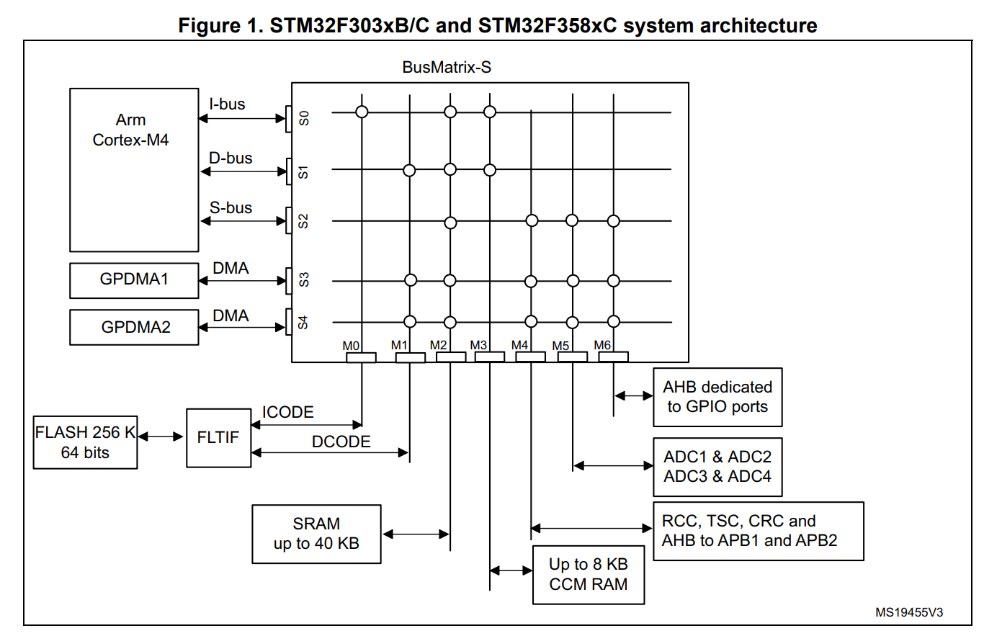
What’s all this other stuff near the CPU?
Finally we answer how the CPU deals with latency.

Slide 4
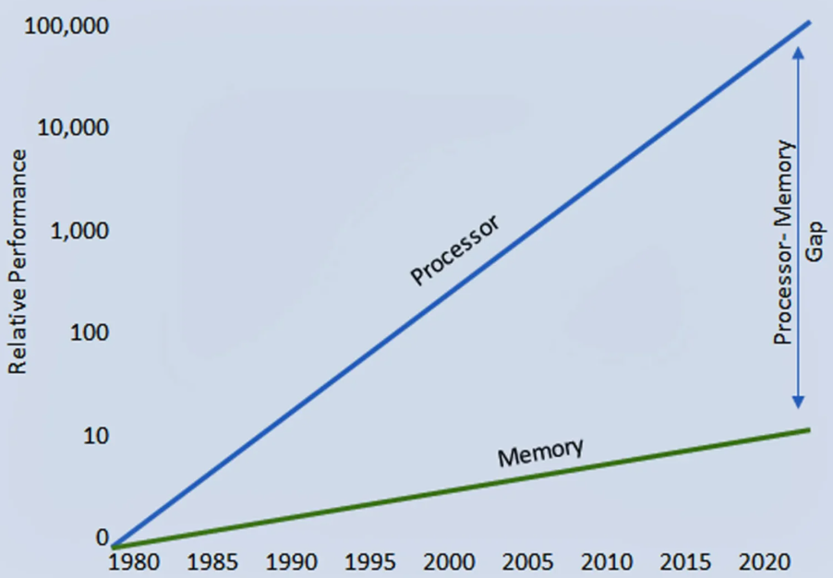
The Memory Wall
CPU speed has increased much faster than memory speed.
Memory becomes the limiting factor!

Slide 5
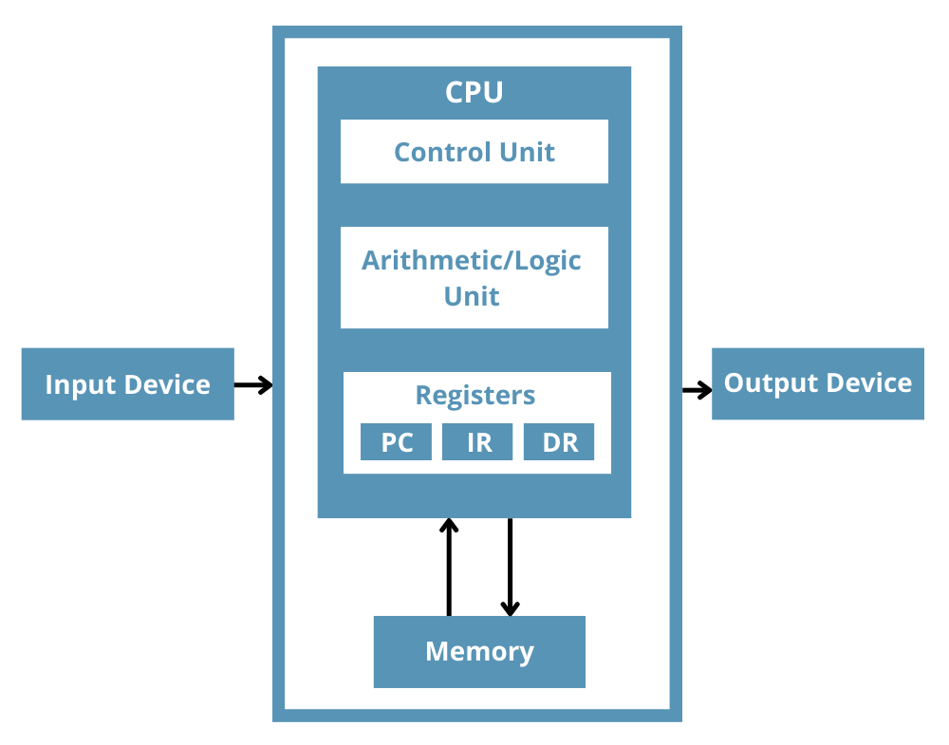
Registers → Caches
We already have the idea of registers which are very fast…
We know from previous lectures that registers are basically memory…
Sooo…

Slide 6
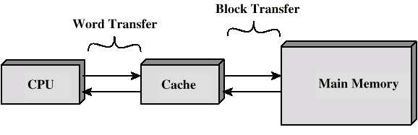
Registers → Caches
Put some memory right by the CPU!
This memory keeps copies of data we access frequently.

Slide 7
Why Caches Work
Assume two memories in a system:
1 mS (Memory 1)
100 mS (Memory 2)
If 95% of memory accesses on faster level, average access time:
(0.95)(1mS) + (0.05)(100mS) = 0.95mS + 5mS
= 5.95mS

Slide 8
Cache Operation
CPU requests memory location.
Check cache
If present, return from cache (“cache hit”)
If not, read from main memory and copy to cache (“cache miss”)

Slide 9
Memory Access Time
Calculate Average Memory Access Time (AMAT):
T_{hit} = Cache hit time
MissRate = fraction of accesses that miss
MissPenalty = Extra cache miss time (e.g., above T_{hit})
Normally times = CPU Cycles

Slide 10
Data vs. Instruction Caches
If we have an instruction cache (not just data memory), we can convert the above to a Cycles Per Instruction (CPI):

Slide 11
Why Caches Work (Cont’d)
If we can get the majority of data access to fast memory, we still win big.
Occasional slow copies from memory are fine, worth copying to fast memory when possible.

Slide 12
Why Caches Work: Temporal Locality
for(int i=0;i<100;i++) sum += array[0];
Memory accessed recently is very likely to be accessed again.
If we access data, very likely we will access it again soon.

Slide 13
Why Caches Work: Spatial Locality
Functions often access data in similar areas (think stack usage!). Or for example another loop:
for(int i=0;i<100;i++) sum += array[i];
If we access data, very likely we will access nearby data.

Slide 14
Why Caches Work: Instruction Access
Programs tend to follow linear flow.
Many jumps will be within a short area (e.g., think if() statements).

Slide 15
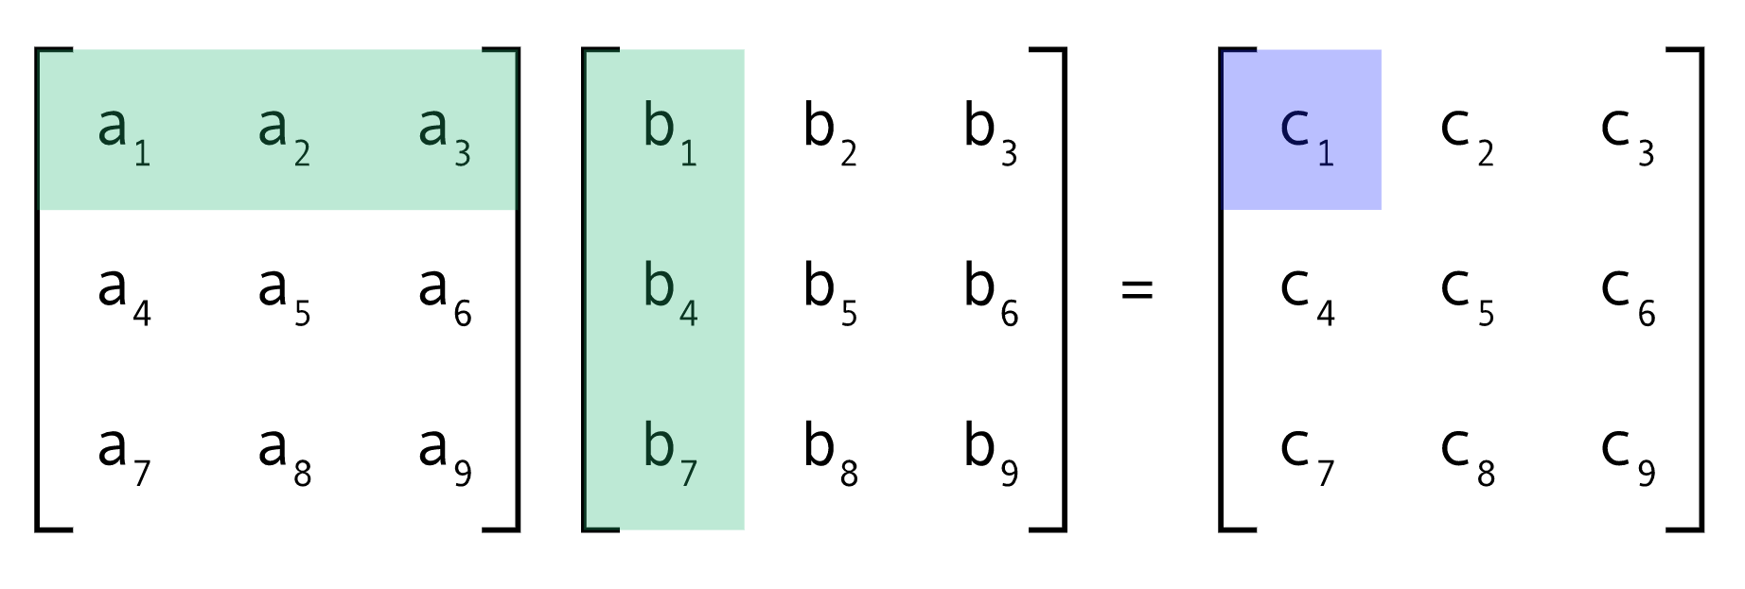
Why Caches Work: Compilers & Designers
Compilers (or designers) can optimize both data and instructions for cache usage.
Example of a simple matrix multiply:

Slide 16
i-j-k
for (i = 0; i < N; i++) {
for (j = 0; j < N; j++) {
for (k = 0; k < N; k++) {
C[i][j] += A[i][k] * B[k][j];
}
}
}
A[i][k]: walks across a row (good)
B[k][j]: walks down a column (bad)
C[i][j]: same element reused in the inner loop (good)

Slide 17
i-k-j
for (i = 0; i < N; i++) {
for (k = 0; k < N; k++) {
for (j = 0; j < N; j++) {
C[i][j] += A[i][k] * B[k][j];
}
}
}
A[i][k]: one value reused across the whole inner (very good)
B[k][j]: walks across a row of B (good)
C[i][j]: walks across a row of C (good)

Slide 18
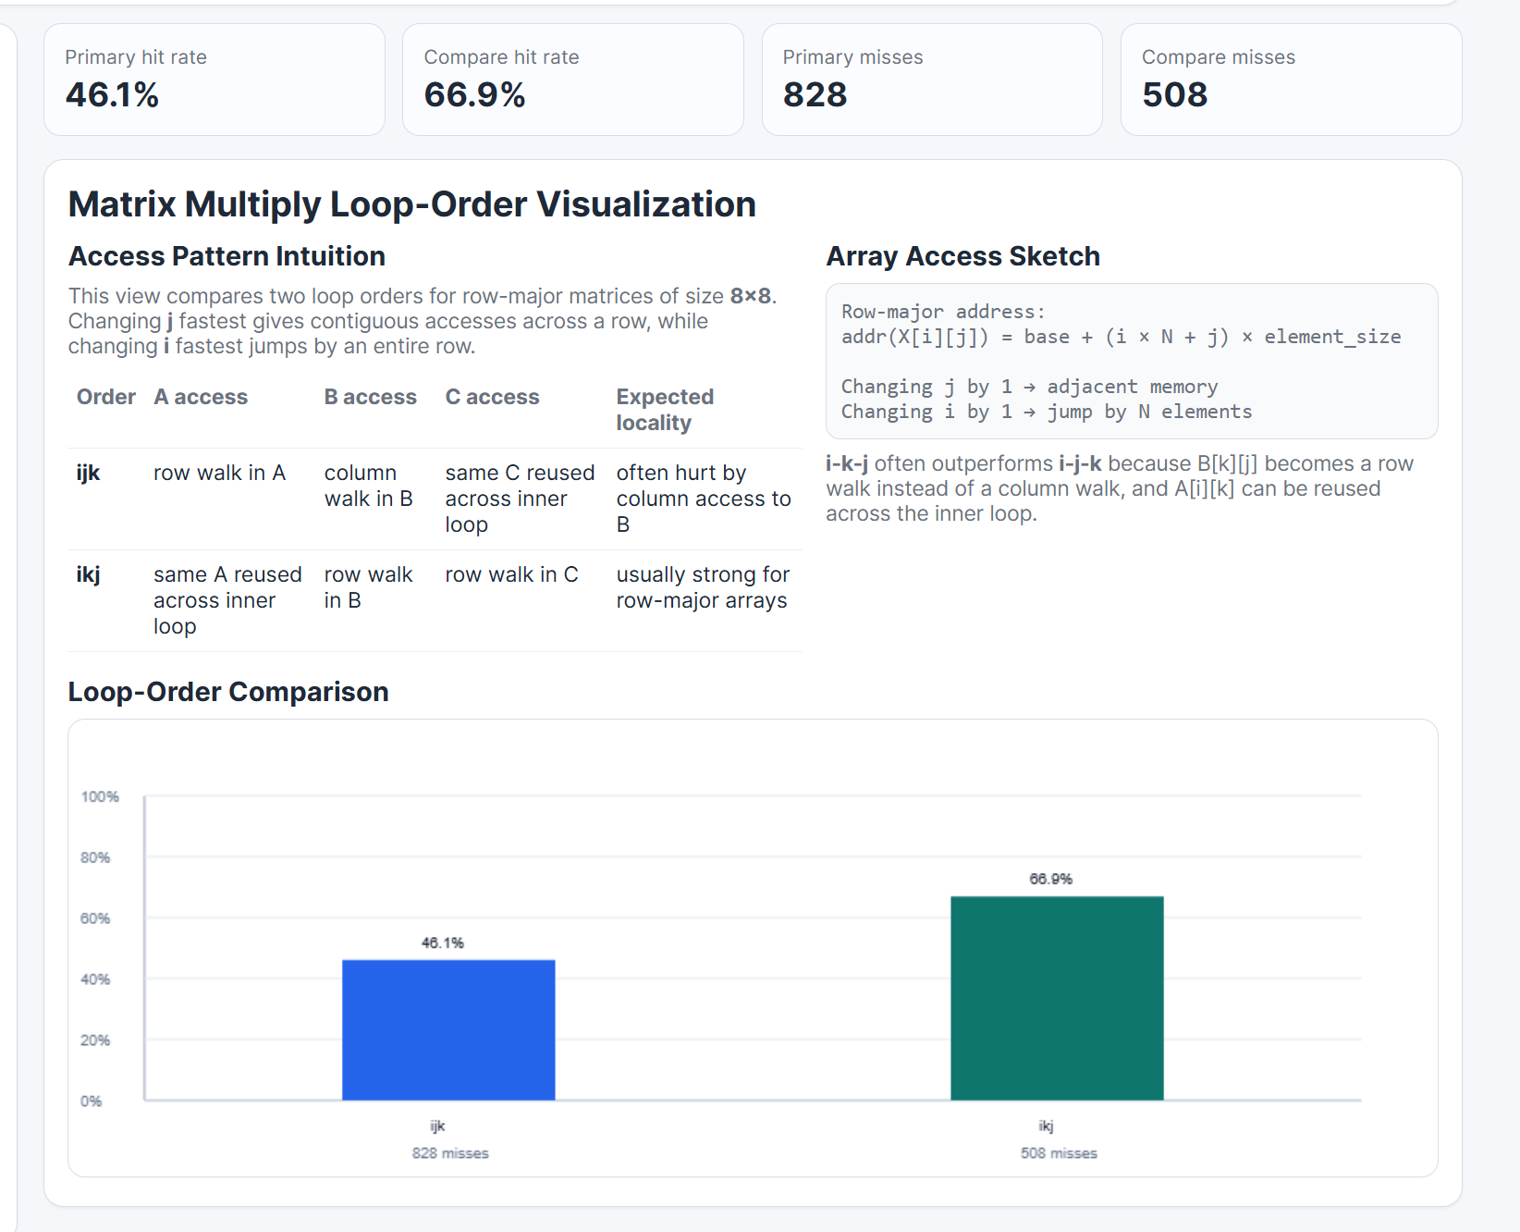
Demo
(See cache_simulator_tool.html in class repo)

Slide 19
Address
addr(X[i][j]) = base + (i * N + j) * element_size
Changing by “j” jumps only by 1 (in cache)
Changing by “1” jumpers by N (maybe out of cache)

Slide 20
IJK Address Example
0,
1000000,
2000000,
8,
1000080,
2000000,
16,
1000160,
2000000,
24,
1000240,
2000000,
32,
1000320,
2000000,
40,
1000400,
2000000,
48,
1000480,
2000000,
56,
1000560,
2000000,
64,

Slide 21
IKJ Address Example
0,
1000000,
2000000,
0,
1000008,
2000008,
0,
1000016,
2000016,
0,
1000024,
2000024,
0,
1000032,
2000032,
0,
1000040,
2000040,
0,
1000048,
2000048,
0,
1000056,
2000056,
0,
,

Slide 22
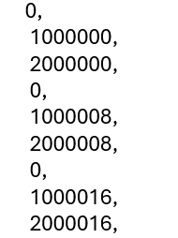
Important Cache Note
Note that the addresses access different areas of memory.
The cache is smart enough to track multiple different areas
It does this through a method of memory tags
e.g., in IKJ example
Tag 1
Tag 2
Tag 3

Slide 23
Cache Structure
Cache includes tags to identify the address of a block of main memory.
Main memory is divided into blocks of K words, meaning have up to:
M = 2^{n} / K possible blocks
Cache could have up to C blocks of main memory

Slide 24
Cache Structure (continued)
Line number 0 1 2
C-1
Tag Block
Block length (K words)

Slide 25
Memory Divided into Blocks
Memory Address
1 2 3
2^{n}-1
Block of K words
Block
Word length

Slide 26
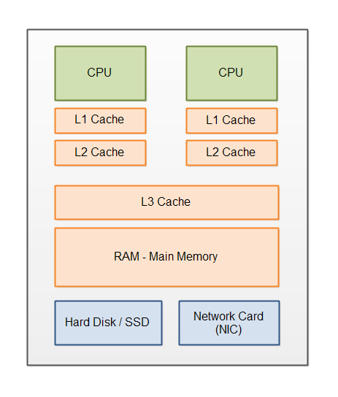
Memory Hierarchy with Multiple Caches
Modern CPUs may include multiple levels of caches – L3 / L2 / L1
Small embedded devices typically have one level but may have different instruction & data caches

Slide 27
Multi-Level Access Time
T_{L1} = Level 1 hit time
MR_{L1} = Miss Rate on Level 1
T_{L2} = Level 2 hit time
MR_{L2} = Miss Rate on Level 2
MissPenalty_{Mem} = Extra cache miss time (e.g., above MR_{L2})
Normally times = CPU Cycles

Slide 28
Formula Intuition
Multiple levels of caches allow us to optimize by going for:
Very fast L1 that has a moderate miss rate
“Moderate miss rate” → Smaller
Fast L2 with a lower miss rate
“Lower miss rate” → Larger

Slide 29
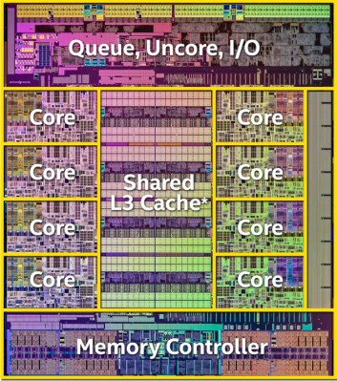
Memory Hierarchy
Compare the area of the L3 cache to the CPU core itself (L2 & L1 are inside each of the cores)
Memory access is one of the most fundamental problems in CPU speed.

Slide 30
Cache Design Questions
Size
Mapping Function
Replacement Algorithm
Write Policy
Block Size
Number of Caches

Slide 31
Cache size
Cost – More cache is expensive
Speed
More cache is faster (up to a point)
Larger decoding circuits slow up a cache
Algorithm is needed for mapping main memory addresses to lines in the cache. This takes more time than just a direct RAM

Slide 32
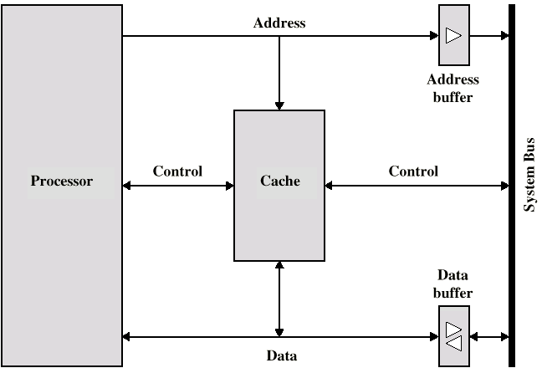
Typical Cache Organization

Slide 33
Mapping Functions
A mapping function is the method used to locate a memory address within a cache
It is used when copying a block from main memory to the cache and it is used again when trying to retrieve data from the cache
There are three kinds of mapping functions
Direct
Associative
Set Associative

Slide 34
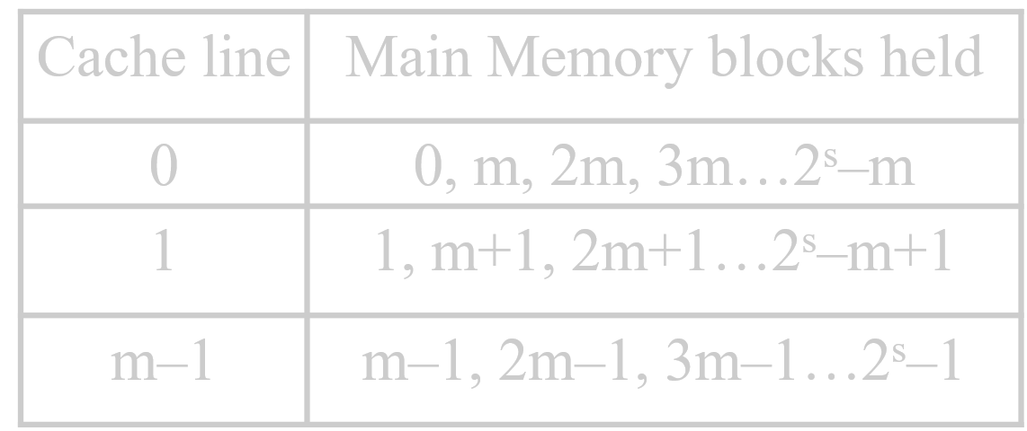
Direct Mapping
Each block of main memory maps to only one cache line
If a block is in memory, it is always found in the same cache line

Slide 35
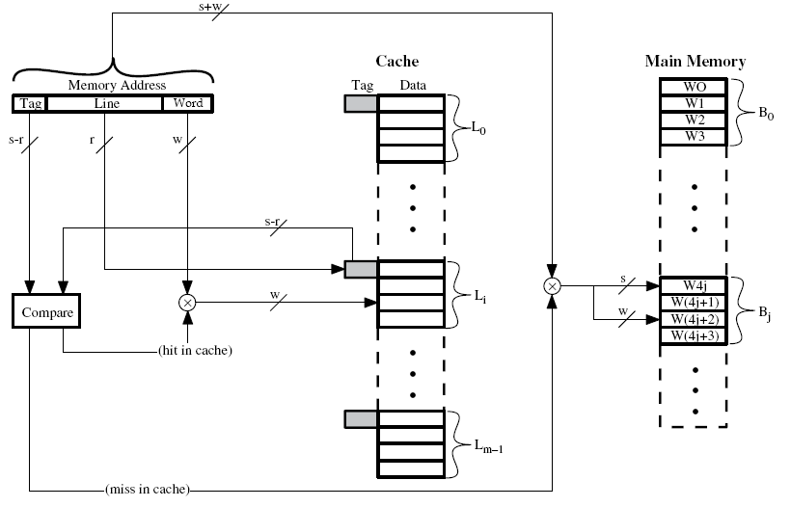
Direct Mapping Access

Slide 36
Direct Mapping Features / Problems
Simple & Easy / Fast to Implement
Can calculate cache line from address
A program accessing 2 blocks mapping to the same line repeatedly causes “thrashing”
This has very poor performance as cache has constant misses

Slide 37
Associative Mapping
Load blocks as used into cache lines
Need to search cache lines to find possible mrmory

Slide 38
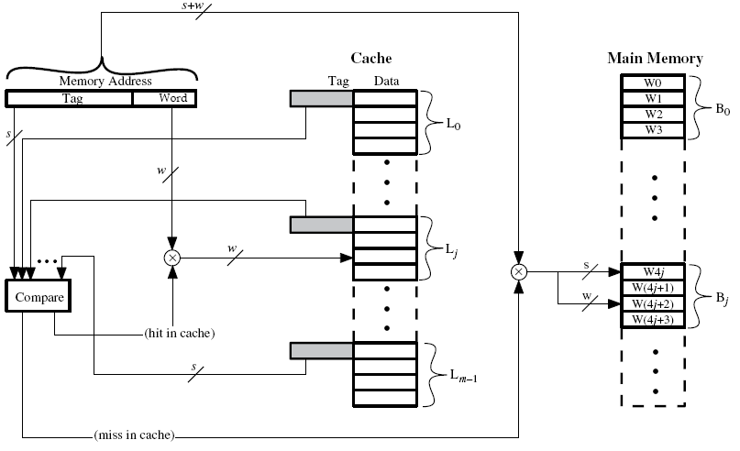
Fully Associative Mapping

Slide 39
Fully Associative Mapping Problems
Search of a large cache is problematic! Ruins the point of a cache…
So split the search up into smaller sections.
We say there is k blocks/lines in each set
k = 1 is direct mapping (only one block it can be in)
k = 2 is common (2 possible blocks to search)

Slide 40
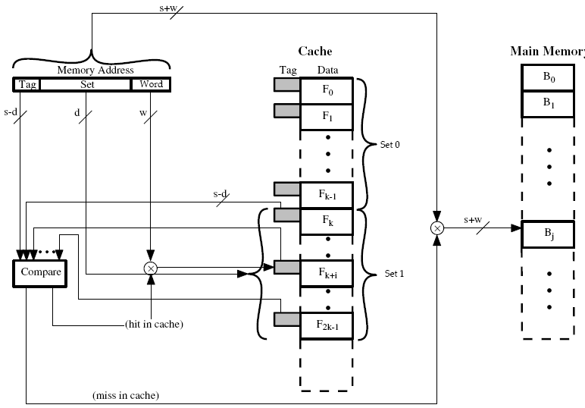
K-Way Associative Mapping

Slide 41
Replacement Algorithm
For direct mapping no algorithm – we have only one choice for where a new block goes.
Associative & Set Associative have choices. Typically:
Least Recently Used (LRU)
Replace block not touched in the longest time
With 2-way associative store this in a bit, set a bit when one set is used. Replace unused set.
First In First Out (FIFO) needed for more sets

Slide 42
Writing to Cache
What happens when your processor writes to memory?
Complexities:
If we write to cache, main memory is invalid.
If we write to memory, cache is invalid.
Consider also multiple CPU cores, or peripherals (DMA) accessing memory.

Slide 43
Write through
All writes go to main memory and cache
Other CPUs monitor main memory traffic to keep cache up-to-date
Downsides:
Lots of bus traffic!
Slows down writes (memory access on every write)

Slide 44
Write back
Writes update cache only
Cache tracks that an update (write) has happened
If block in cache to be removed (flushed), check if update happened, if so write back to main memory
Downsides:
Other caches get out of sync
I/O must access main memory through cache

Slide 45
Dealing with Multi-core
Processors monitor bus to see if any writes of interest to them have occurred
Overseer monitors all caches and forces synchronization between them
Memory is marked as non-cacheable

Slide 46
Embedded Processor Caches
Smaller embedded systems will often not have caches.
Normally there is a separate instruction cache (ICACHE) and data cache (DCACHE)
STM32F303 (Cortex-M4 based) does not have either.

Slide 47
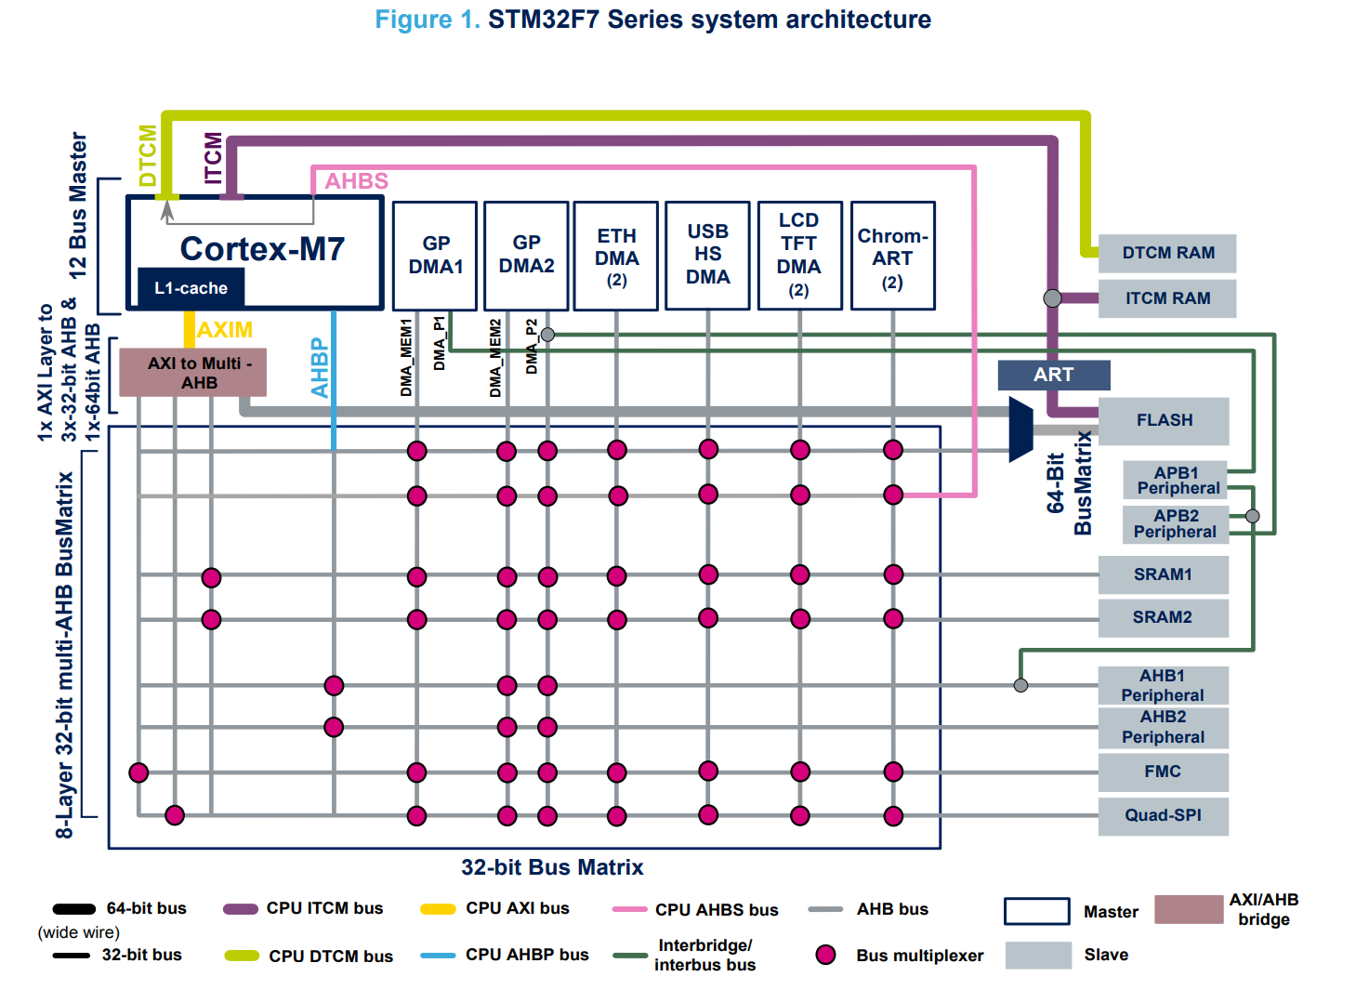
e.g., STM32F7

Slide 48
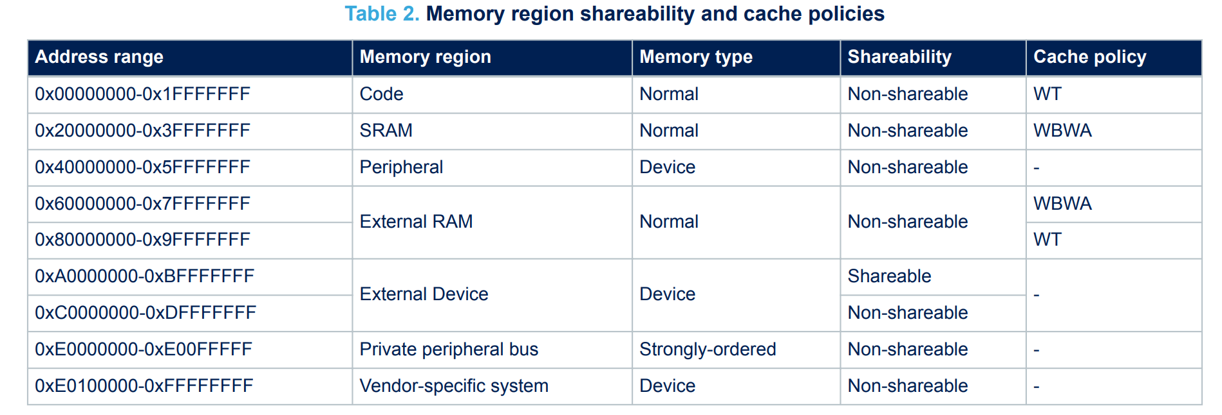
e.g., Default Cache Setup

Slide 49
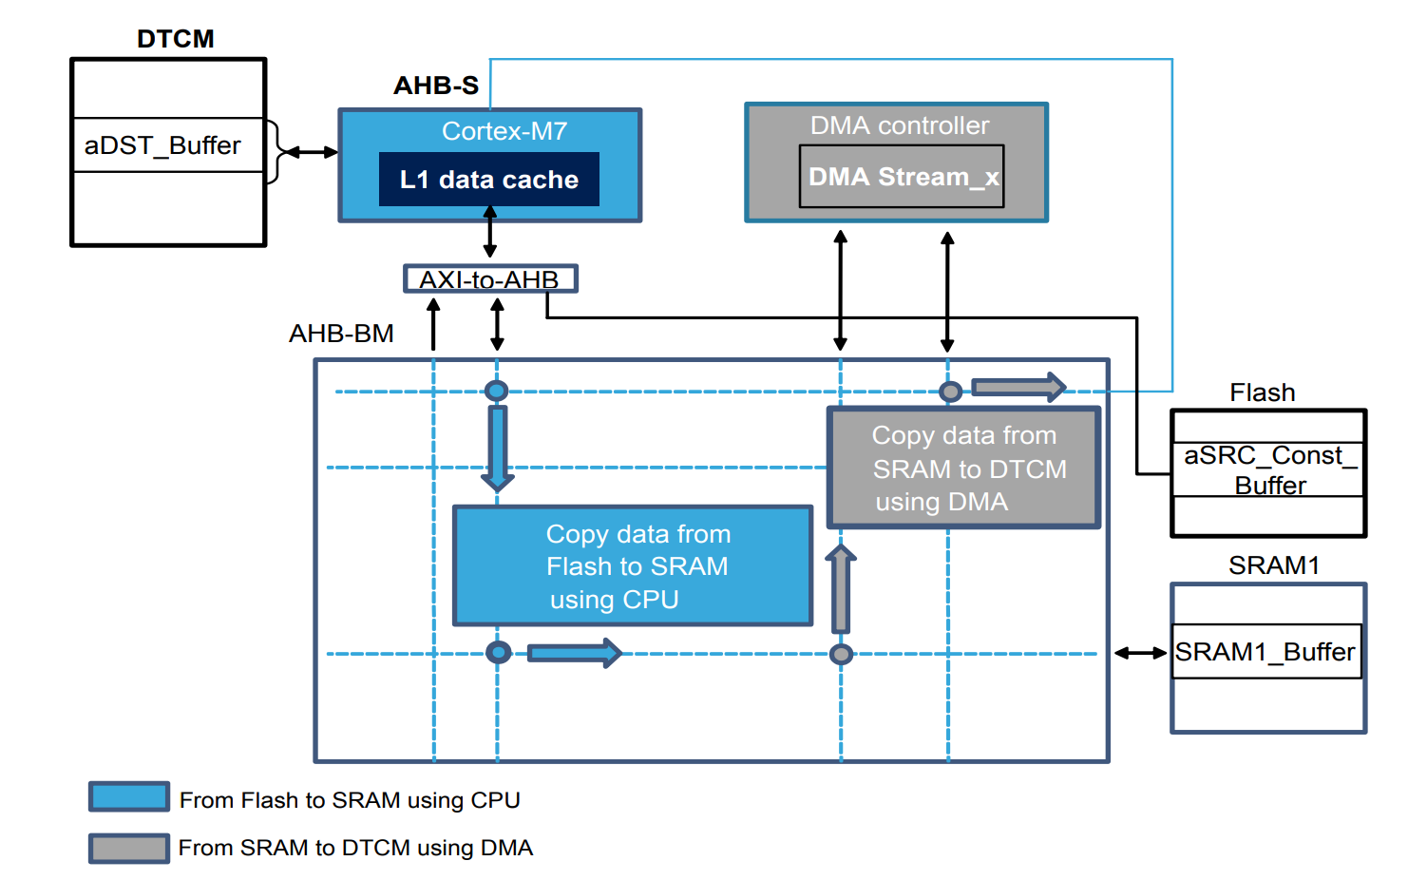
e.g., Cache Problems

Slide 50
e.g., Fixing Data Coherency
Solution 1:
Manual cache maintenance operation: SCB_CleanDCache() when coherence problem exists (DMA).
Solution 2:
Modify SRAM1 to be “Write-Through” policy (WT instead of WBWA)
Solution 3:
Modify SRAM1 to be shared attribute (prevents D-cache usage)
Solution 4:
Modify all writes to be “Write-Through”

Slide 51
Memory Caches & Performance
Caching is an important solution to the memory wall problem.
Caching also helps with general bus contention problems.
Different cache access patterns can drastically affect software performance.
Reviewed cache tags & replacement policy.
Reviewed some examples of cache usage on STM32F7

